Slide 1
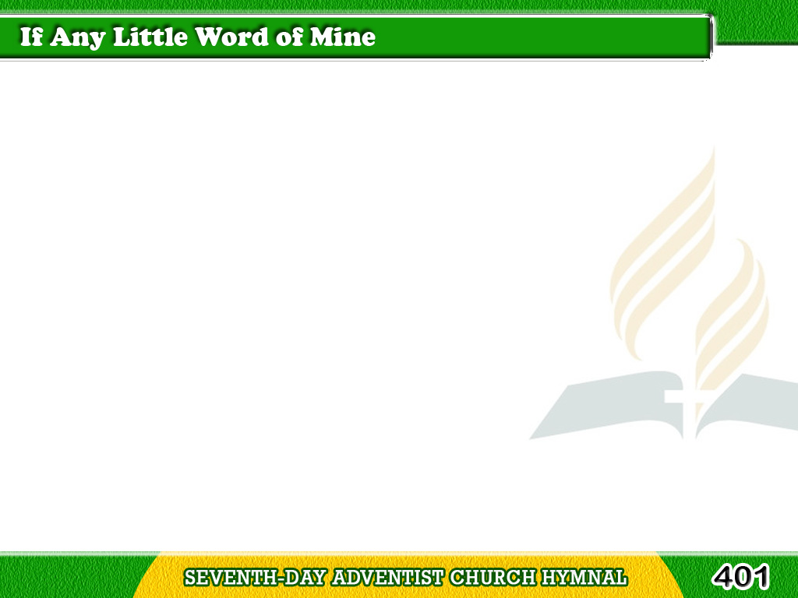
1/3
If any little word of mine
May make a dark life brighter,
If any little song of mine
May make a sad heart lighter,
Tagalog
Version

Slide 2
1/3
Chorus
God help me speak
the helping word,
And sweeten it with singing,
And drop it in some lonely vale,
To set the echoes ringing.
Tagalog
Version

Slide 3
2/3
If any little love of mine
May make a hard life sweeter,
If any little care of mine
May make a friend’s the fleeter,
Tagalog
Version

Slide 4
2/3
Chorus
God help me speak
the helping word,
And sweeten it with singing,
And drop it in some lonely vale,
To set the echoes ringing.
Tagalog
Version

Slide 5
3/3
If any little lift of mine
May ease a toiler bending,
God give me love and care
and strength;
We live for Him by lending.
Tagalog
Version

Slide 6
3/3
Chorus
God help me speak
the helping word,
And sweeten it with singing,
And drop it in some lonely vale,
To set the echoes ringing.
Tagalog
Version

